Slide 1
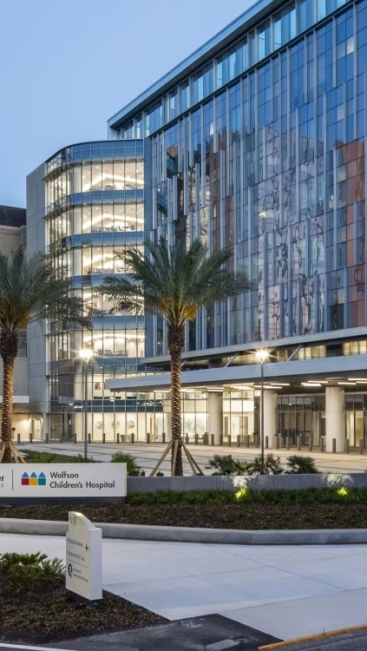


OPPORTUNITY REVIEW
DIRECT-TO-EMPLOYER GTM STRATEGY
Exploring a Baptist Health DTE Health Plan

Slide 2


Founded in 1979, headquartered in Indianapolis
Largest Independently-Owned Full-Service Third-Party Administrator
Specialize in Administration of Self-Funded Plans and Population Health Management​
Leader in the Direct-to-Employer Movement
We Know and Understand the Market
Experience Working with All Professional Teams: Agents, Networks, MGAs
The Key Family of Companies is a Vertically Integrated group of benefit related organizations
3,000+ Corporate Clients
3 Million Members under Management
700 Employees

Slide 3



Our Founding and Heritage: 46 Years of Striving for Honesty in Healthcare

Slide 4
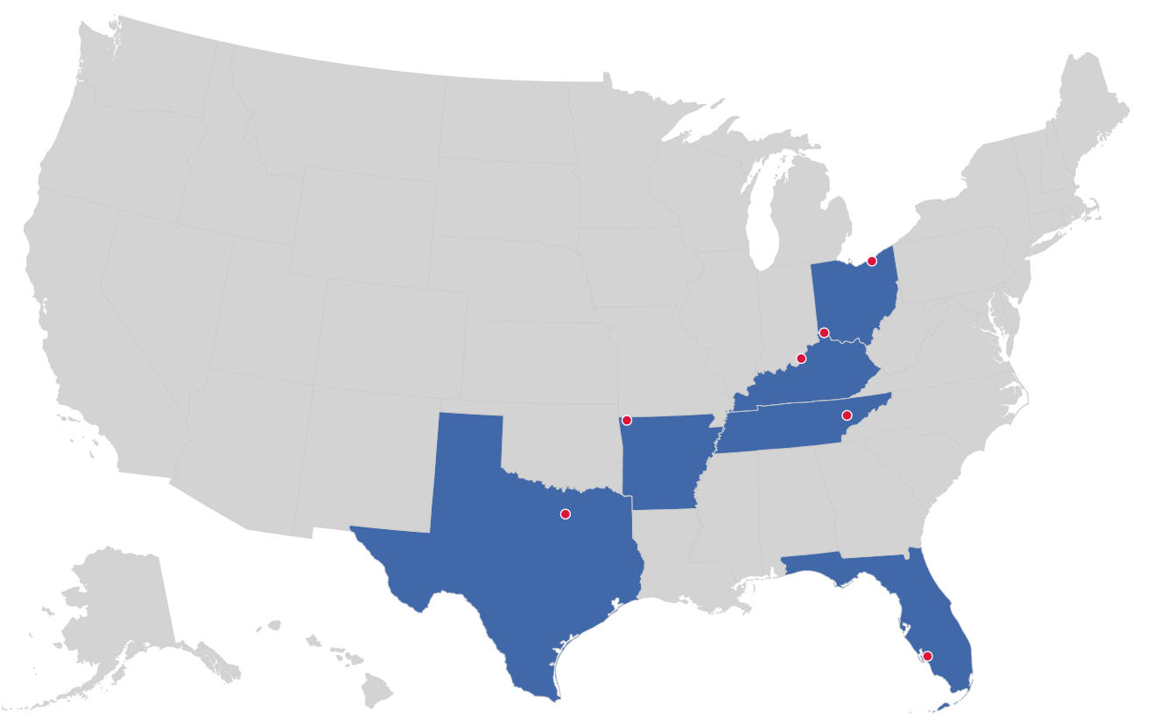

MARKET LEADER
IN
PRIVATE LABELED
DTE PLANS
Cleveland, OH
Louisville, KY
Cincinnati, OH
Bentonville, AR
Knoxville, TN
Dallas Fort Worth, TX
Fort Myers, FL

Slide 5
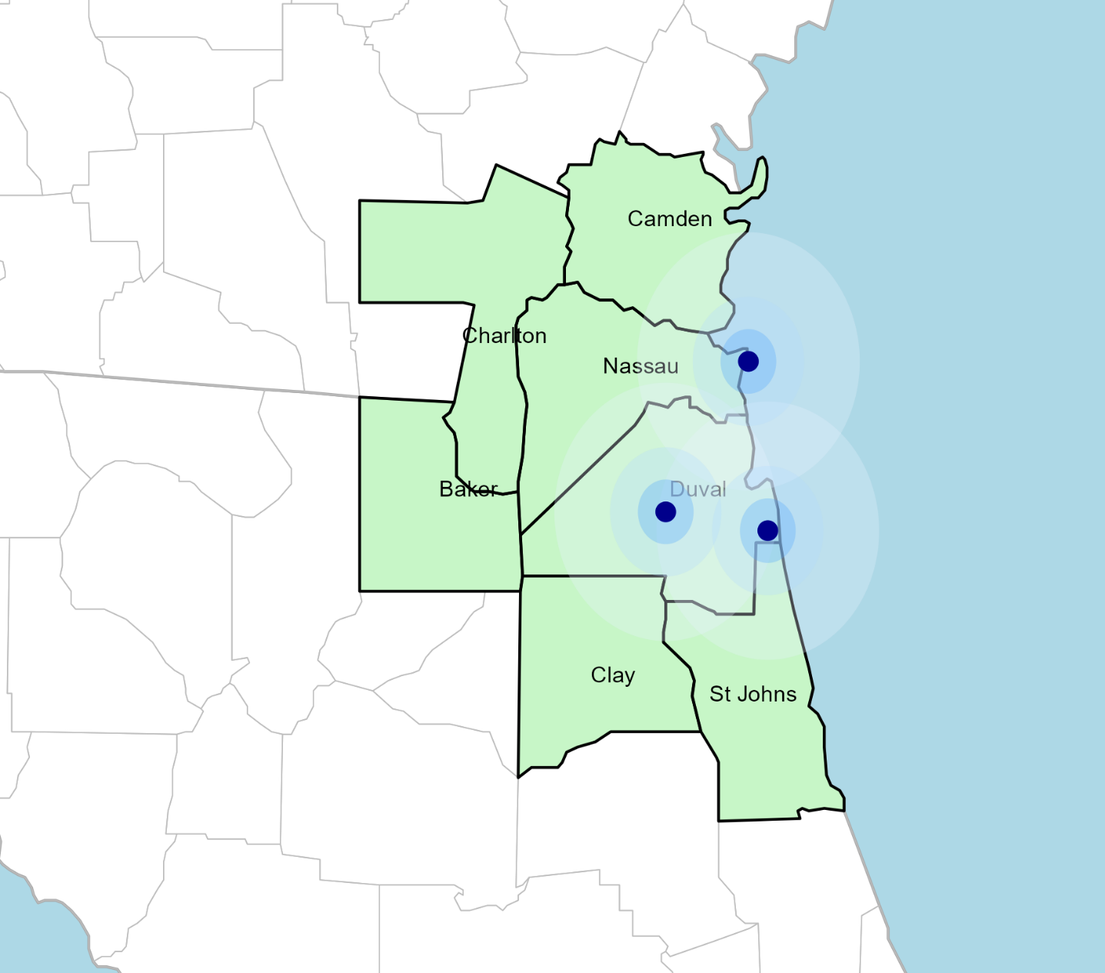
SIGNIFICANT OPPORTUNITY FOR PLAN GROWTH Researched for the below highlighted service area
Target Market 1,500+ Employers 400,000+ Employees 600,000+ Members
 | Employer Size Group (# of Employees)
Commercial Employers With Headquarters | 50-100 | 101-200 | 201-400 | 401-1,000 | 1,001-3,000 | 3,000+
In Catchment Area | 911 | 352 | 192 | 141 | 56 | 29
Total Employees at Employers | 50-100 | 101-200 | 201-400 | 401-1,000 | 1,001-3,000 | 3,000+
Headquartered in Catchment Area | 68,325 | 52,800 | 57,600 | 98,700 | 112,000 | 319,000
Total Members with Employers | 50-100 | 101-200 | 201-400 | 401-1,000 | 1,001-3,000 | 3,000+
Headquartered in Catchment Area | 122,985 | 95,040 | 103,680 | 177,660 | 201,600 | 574,200

Slide 6
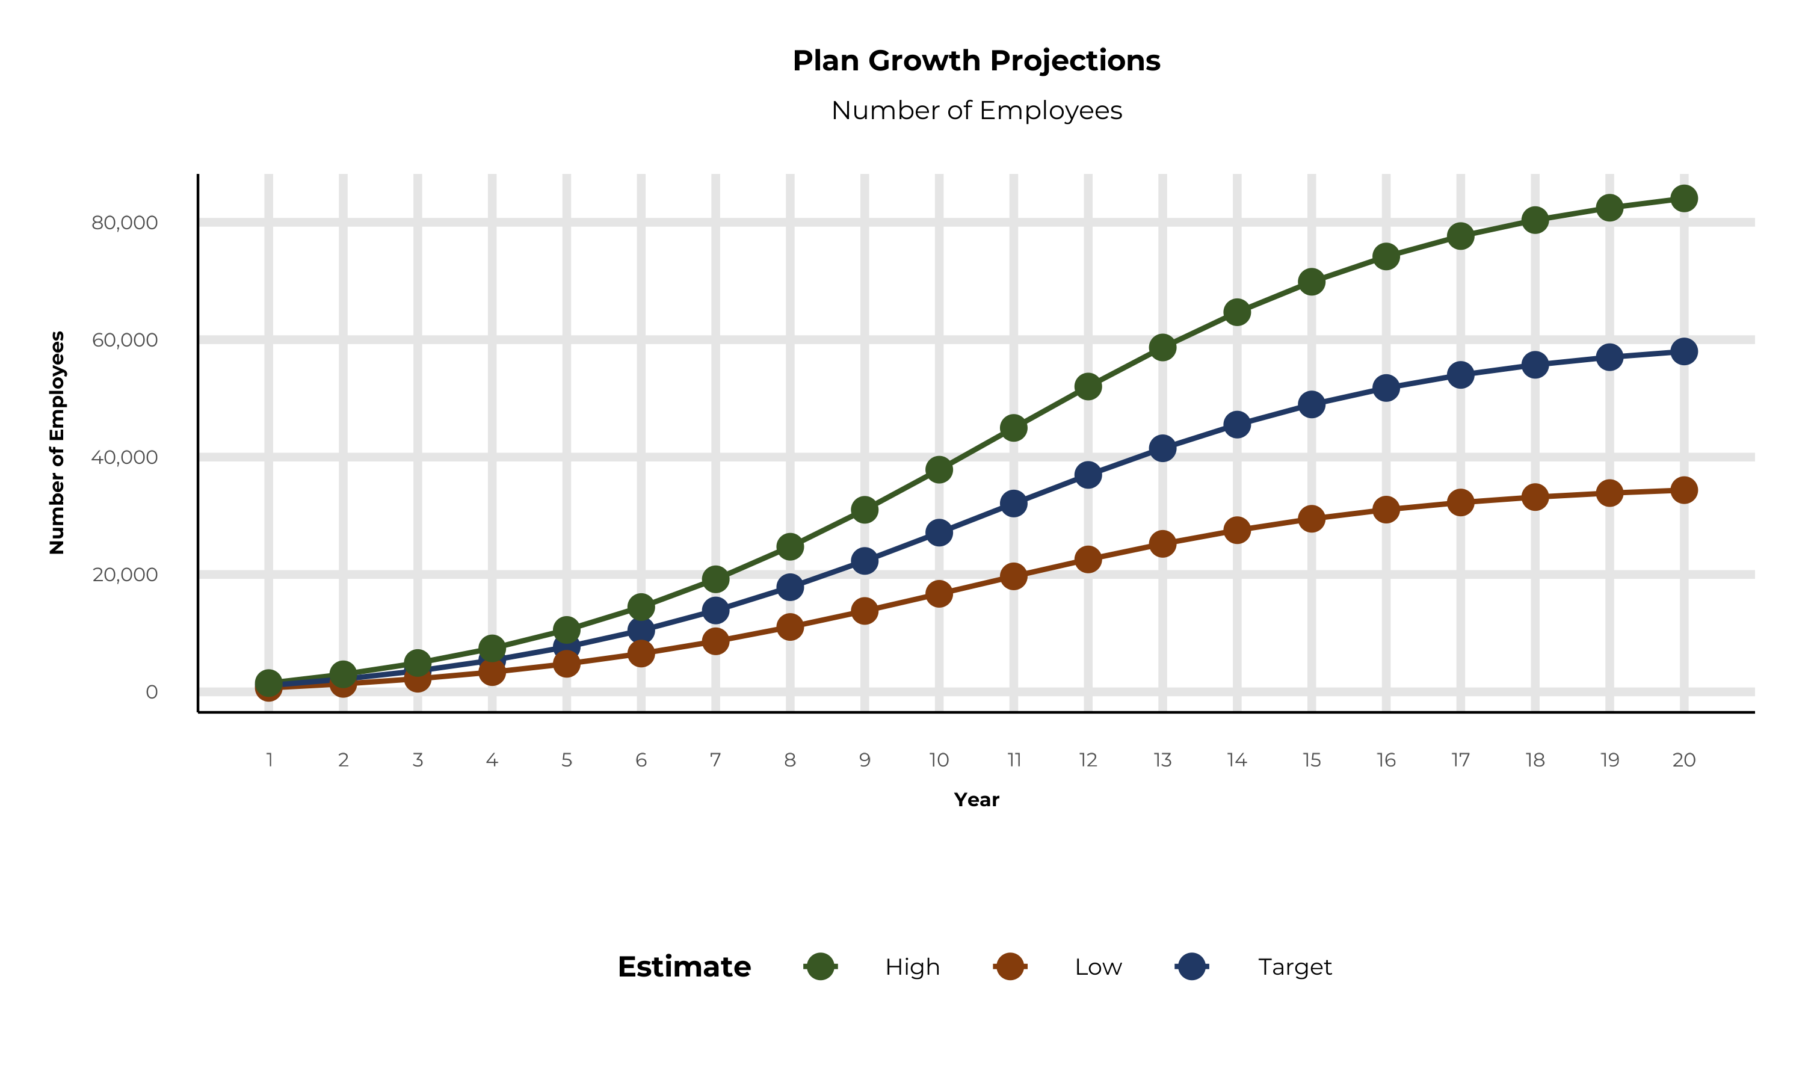
PLAN POTENTIAL GROWTH PATHS
Self Funded
397K
Insured
656K
Working Age
978K
Population
1,681K
Estimates includes the Baptist Health service area in Baker, Clay, Duval, Nassau, St. Johns, Camden, and Charlton Counties

Slide 7
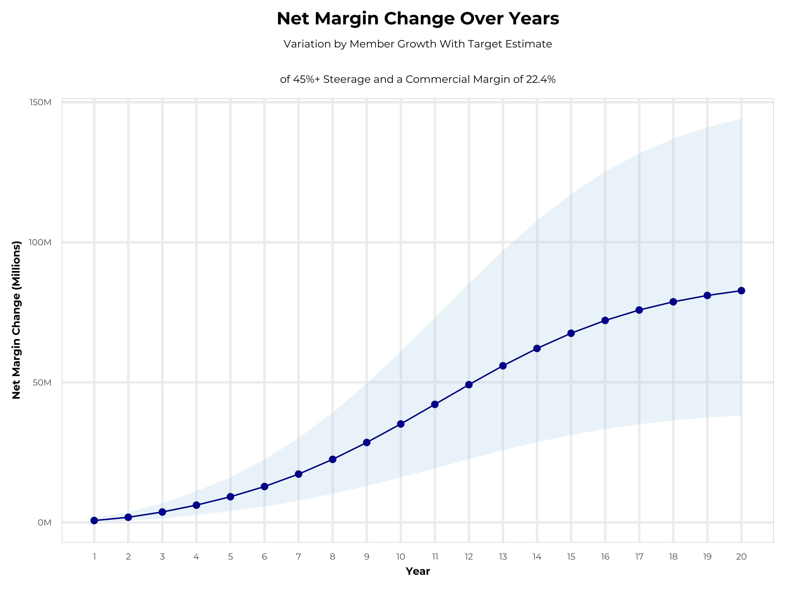
GROWING POWERFUL, LASTING PROFITABILITY
Early Stage
Gaining Name Recognition, Early Growth
New Revenue:
New Profit:
$21.36M
$5.73M
Growth Stage
Strong Reputation, Strong Growth
New Revenue:
New Profit:
$129.89M
$35.81M
Mature Stage
High Profitability, Market Saturation
New Revenue:
New Profit:
$269.11M
$74.29M

Slide 8
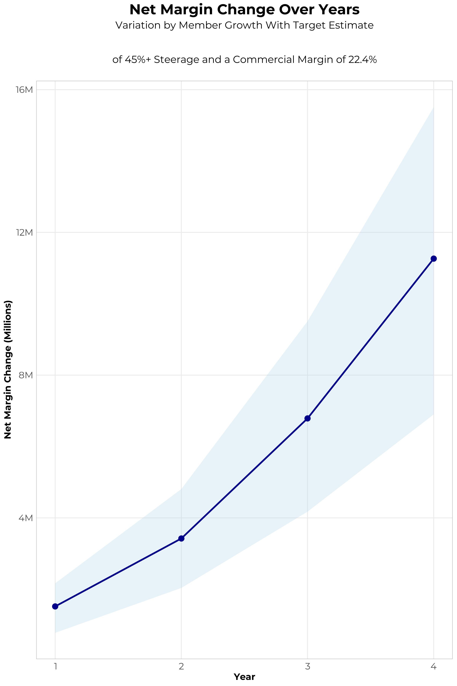
FOUR-YEAR PROJECTIONS
Target Member Growth | Target Member Growth | Target Member Growth | Target Member Growth | Target Member Growth
Metric | Year 1 | Year 2 | Year 3 | Year 4
Number of Members | 2,000 | 3,900 | 6,400 | 9,700
Incremental Margin | 1,825.2K | 3,556.3K | 6,890.9K | 11,328.7K
Network Access Fee | 24.0K | 46.8K | 76.8K | 116.4K
Implementation Fee (One-Time) | -150.0K | 0.0K | 0.0K | 0.0K
Sales and Marketing Costs | -180.0K | -180.0K | -180.0K | -180.0K
Net Margin Change | 1,519.2K | 3,423.1K | 6,787.7K | 11,265.1K
High Member Growth | High Member Growth | High Member Growth | High Member Growth | High Member Growth
Metric | Year 1 | Year 2 | Year 3 | Year 4
Number of Members | 2,700 | 5,400 | 8,900 | 13,300
Incremental Margin | 2,464.1K | 4,924.1K | 9,582.7K | 15,533.1K
Network Access Fee | 32.4K | 64.8K | 106.8K | 159.6K
Implementation Fee (One-Time) | -150.0K | 0.0K | 0.0K | 0.0K
Sales and Marketing Costs | -180.0K | -180.0K | -180.0K | -180.0K
Net Margin Change | 2,166.5K | 4,808.9K | 9,509.5K | 15,512.7K
Low Member Growth | Low Member Growth | Low Member Growth | Low Member Growth | Low Member Growth
Metric | Year 1 | Year 2 | Year 3 | Year 4
Number of Members | 1,200 | 2,400 | 4,000 | 6,000
Incremental Margin | 1,095.1K | 2,188.5K | 4,306.8K | 7,007.4K
Network Access Fee | 14.4K | 28.8K | 48.0K | 72.0K
Implementation Fee (One-Time) | -150.0K | 0.0K | 0.0K | 0.0K
Sales and Marketing Costs | -180.0K | -180.0K | -180.0K | -180.0K
Net Margin Change | 779.5K | 2,037.3K | 4,174.8K | 6,899.4K

Slide 9

DIRECT-TO-EMPLOYER STRATEGY: ONLY AVAILABLE TO PREMIER HEALTH SYSTEMS
STRONG Brand Quality
EXTENSIVE Patient Access
AFFORDABLE Value Pricing
EXCELLENT Care Quality

Slide 10
BAPTIST HEALTH IS PATIENT RECOMMENDED
Health System | HCAHPS Recommendation Percentile | CMS Stars Percentile | Mortality Percentile | Readmission Percentile | KBA Brand Quality Score
Mayo Clinic | 98 | 100 | 81 | 63 | 77
Baptist Health (Jacksonville FL) | 76 | 87 | 75 | 70 | 72
University of Florida Health | 37 | 63 | 68 | 72 | 58
Ascension Health | 40 | 58 | 80 | 60 | 58
HCA Healthcare | 16 | 46 | 88 | 63 | 49
Based on quality measures and HCAHPS feedback, KBA estimates that Baptist Health has one of the strongest brands in Baker, Clay, Duval, Nassau, St. Johns, Camden, and Charlton Counties.

Slide 11
PROJECTED PLAN GROWTH
Year | Employees | Members | Percent of Members Choosing Baptist Health for Inpatient Care | Percent of Members Choosing Baptist Health for Outpatient Care
1 | 1,100 | 2,000 | 55% | 45%
2 | 2,200 | 4,000 | 55% | 45%
3 | 3,600 | 6,500 | 60% | 50%
4 | 5,400 | 9,700 | 62% | 53%
5 | 7,700 | 13,900 | 62% | 54%
6 | 10,500 | 18,900 | 62% | 55%
7 | 13,900 | 25,000 | 63% | 56%
8 | 17,800 | 32,000 | 63% | 56%
9 | 22,300 | 40,100 | 63% | 57%
10 | 27,100 | 48,800 | 64% | 57%
11 | 32,100 | 57,800 | 64% | 58%
12 | 37,000 | 66,600 | 64% | 58%
13 | 41,500 | 74,700 | 65% | 59%
14 | 45,500 | 81,900 | 65% | 59%
15 | 49,000 | 88,200 | 65% | 60%
16 | 51,800 | 93,200 | 65% | 60%
17 | 54,000 | 97,200 | 66% | 61%
18 | 55,700 | 100,300 | 66% | 61%
19 | 57,000 | 102,600 | 66% | 61%
20 | 58,000 | 104,400 | 66% | 61%
KBA currently estimates that Baptist Health has 30% inpatient market share, and 18% outpatient market compared to hospitals/clinics in the Baptist Health service area (see slide 8).
Based on previous DTE experience, KBA expects a significant bump in patient steerage to Baptist Health.
Additional steerage will occur from additional steerage patient benefits and the patient convenience card.
High estimates start nearly 10% higher than target with low estimates at 10% lower than target

Slide 12
YEAR 4 PROJECTED REVENUE AND PROFIT
Pre-DTE Cohort of 9,700 Employees | Inpatient | Outpatient | Professional | Total
Revenue† | $ 9,825,129 | $ 10,791,230 | $ 5,039,412 | $ 25,655,771
Net Income‡ | $ 2,672,435 | $ 2,935,214 | $ 1,370,720 | $ 6,978,370
† Assuming proportional revenues from market shares of 30% (inpatient) and 18% (outpatient)
‡ Conservatively assuming a commercial margin of 27.2% (80% of the estimated commercial margin)
With DTE | Inpatient | Outpatient | Professional | Total
Revenue⁰ | $ 20,329,329 | $ 31,730,248 | $ 14,817,756 | $ 66,877,333
Net Income* | $ 5,529,577 | $ 8,630,627 | $ 4,030,430 | $ 18,190,635
⁰ Assuming 62% inpatient and 53% market steerage based on KBA narrow network DTE experience (see previous slide)
* Conservatively assuming a commercial margin of 27.2%, with a 10 percentage-point reduction to reflect competitive-edge rates and a 10 percentage-point increase due to lower billing costs and higher patient responsibility collections because of the member convenience card.
Total Increase in Net Income | $ 11,212,265
Network Access Fee (Revenue) of $1 PMPM | $ 116,400
Total Profit Growth | $ 11,328,665
Minus Implementation Fee (One-Time) | -$ 0
Minus Sales and Marketing (Annual – Ongoing) | -$ 180,000
Total | $ 11,148,665

Slide 13

A PARTNER YOU CAN TRUST
OUR OBJECTIVES ARE ALIGNED
WE KNOW THE
MARKET
COMPLETELY TRANSPARENT
WE HAVE THE SOPHISTICATION AND INFRASTRUCTURE TO EFFECTIVELY COMPETE
Derek Moore, Senior Vice President – KBA
845-283-9973 * derek.moore@keybenefit.com

